Slide 1

HTML Basics
Hypertext Markup Language
SoftUni Team
Technical Trainers
Software University
https://softuni.bg

Slide 2
Table of Contents
What is HTML?
Element Anatomy
Document Anatomy
Formatting Text
Attributes
Images, Links and Forms
Multimedia Context
Nested Elements

Slide 3
Questions?
sli.do
#fund-common

Slide 4

HTML
Formatted Text for the Web Browser

Slide 5


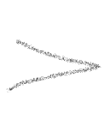


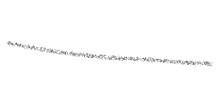


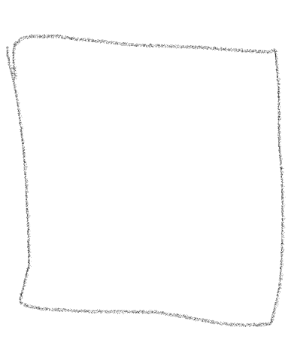
Welcome to HTML
HTML == standard markup language for creating and displaying web content
browser
5

Slide 6
What is HTML?
HTML is not a programming language
It is a markup language
Tells your browser how to display the pages
Consists of series of elements
E.g. <p>Some text</p>
Used to display formatted text
It’s just a text file with .html extension
6
Notes:
HTML (Hypertext Markup Language) is the code used to build and display a web page and its content
Standard markup language for creating web content
It represents a series of elements that you use to surround (or wrap) different portions of content to make them look and act in a certain way
HTML is not a programming language - it is a markup language that is used to tell your browser how to display the pages you are visiting.
It’s just a text file with .html extension.

Slide 7

Anatomy of an Element

Slide 8
Element Anatomy
The main parts of an element are:
opening, content and closing tag
Opening tag – it consists of the name of the element surrounded by less than and greater than signs
It indicates where the element starts
Character (Tag name)
Left angle bracket (Less than sign)
Right angle bracket (Greater than sign)
<html>
8

Slide 9
Element Anatomy
Closing tag - Same as the opening tag, but with an additional slash before the item's name
It shows where the element ends
Character (Tag name)
Left angle bracket (Less than sign)
Right angle bracket (Greater-than sign)
</html>
Forward slash (end tag indicator)
9

Slide 10
Element Anatomy
Everything between the opening and closing tags is defined as the content of this element
The element is the set of the opening tag, closing tag and content
<!DOCTYPE html>
<html>
<!-- HTML ELEMENT CONTENT-->
</html>
<body>
<p>Hello, HTML!</p>
</body>
10

Slide 11

Document Anatomy

Slide 12
Document Anatomy
The basic requirement for content that an html file should have
<!DOCTYPE html>
<html lang="en">
<head>
<meta charset="UTF-8" />
<title>HTML</title>
</head>
<body>
<!-- ... -->
</body>
</html>
12

Slide 13

<!DOCTYPE html>
Describes the HTML
It is an instruction for the web browser about what version of HTML the page is written in
The DOCTYPE is supported by all modern web browsers like: Chrome, Firefox, IE, Safari and Opera
<!DOCTYPE html>
. . .
13

Slide 14

The <html> Tag
This element surrounds the entire content of the page
The html element must contain a head element followed by a body element
<!DOCTYPE html>
<html>
<head>
<!-- ... -->
</head>
<body>
<!-- ... -->
</body>
</html>
14

Slide 15
The <head> Tag
Container for metadata
HTML metadata is data about the HTML document but is NOT displayed
Metadata typically define the document title, styles, links, scripts, and other meta information
<!DOCTYPE html>
<html>
<head>
<!-- HEAD ELEMENT CONTENT-->
</head>
<body>
<!-- ... -->
</body>
</html>
15

Slide 16
The <meta> Tag
The information inside the <meta> tag is not displayed on the page but is relied on by the machine
Meta elements are usually used to add a description to the page, keywords or character sets
Meta tags are always in the <head> element
It has no end tag
<head>
<meta charset="UTF-8">
<meta name="description" content="Tutorial">
<meta name="keywords" content="Html,Meta,Tag">
</head>
16
Notes:
The metadata is used by the browser to know how to load the page or reload it, from the search engines (keywords) or other web services.
<meta> tags are always in the <head> element.
Meta elements are usually used to add a description to the page, keywords or character sets.

Slide 17

The <title> Tag
Defines the title of the document
Defines the title in the browser's toolbar
Gives a page title when added to favorites
Shows the title of the page in the search engines
<head>
<title>Software University</title>
</head>
Title
17

Slide 18
The <body> Tag
The main content of the HTML document
The section that will be directly visible on your web page
<!DOCTYPE html>
<html>
<head>
<!-- … -->
</head>
<body>
<!-- BODY ELEMENT CONTENT-->
</body>
</html>
18
Notes:
Head is required and it should be used just once. It should start immediately after the opening html tag and end before the opening body tag.
<body> tag defines the main content of the HTML document or the section of the HTML document that will be directly visible on your web page.

Slide 19
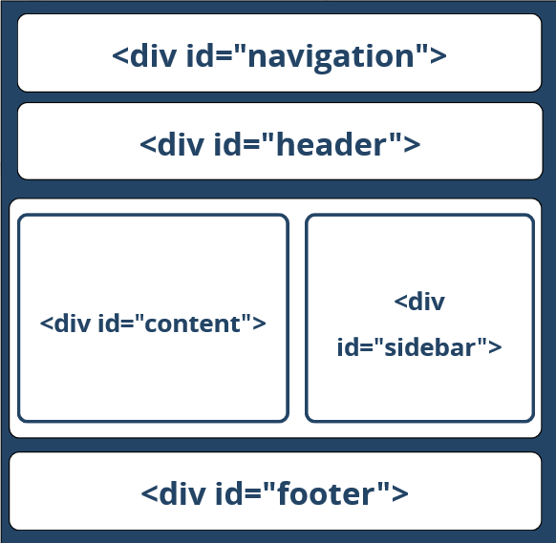
The "HTML4 & Old" Way
Using <div>s with IDs (the IDs are needed for styling)
<html>
<head>
<!-- … -->
</head>
<body>
<div id="navigation">…</div>
<div id="header">…</div>
<div id="sidebar">…</div>
<div id="content">…</div>
<div id="footer">…</div>
</body>
</html>

Slide 20
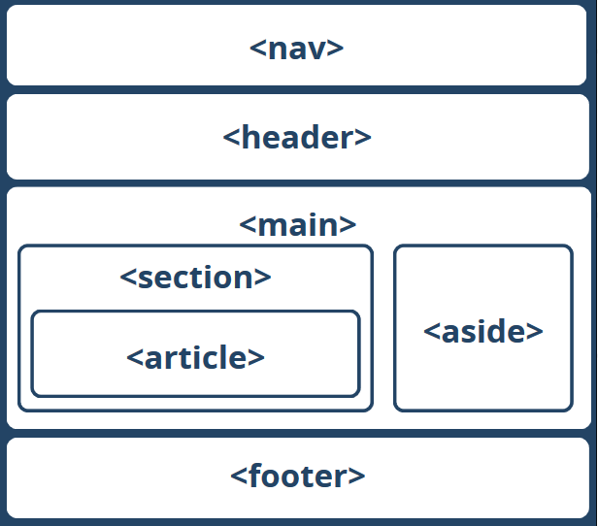
The HTML5 Way
HTML5 uses semantic tags for the document structure
<body>
<nav>…</nav>
<header>…</header>
<main>
<aside>…</aside>
<section>
<article>…</article>
</section>
</main>
<footer>…</footer>
</body>

Slide 21

Formatting Text

Slide 22
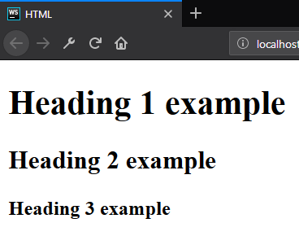
Formatting Text – Heading
Allows you to specify that certain portions of the content are titles or subheadings
<body>
<h1>Heading 1 example</h1>
<h2>Heading 2 example</h2>
<h3>Heading 3 example</h3>
</body>
22

Slide 23
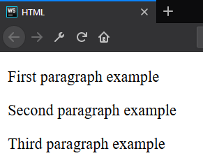
Formatting Text – Paragraph
Is meant to contain the individual paragraphs in the text
<body>
<p>First paragraph example</p>
<p>Second paragraph example</p>
<p>Third paragraph example</p>
</body>
23

Slide 24
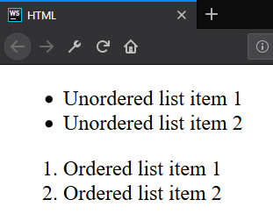
Formatting Text – List
The lists contain at least two elements
The most common types are ordered and unordered lists
Unordered
<ul>
<li>Unordered list item 1</li>
<li>Unordered list item 2</li>
</ul>
<ol>
<li>Ordered list item 1</li>
<li>Ordered list item 2</li>
</ol>
Ordered
24

Slide 25
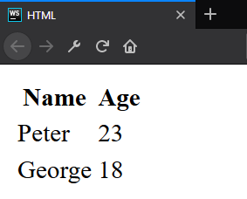
Formatting Text – Table
A structured set of data made up of rows and columns
<table>
<thead>
<tr>
<th>Name</th>
<th>Age</th>
</tr>
</thead>
<tbody>
<tr>
<td>Peter</td>
<td>23</td>
</tr>
<!-- TODO: Add George -->
</tbody>
</table>
25

Slide 26
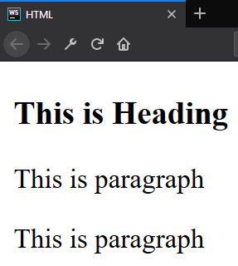
Formatting Text – Division Element
Division element (div) is the generic container for flow content
It has no effect on the content or layout
As a "pure" container, the <div> element does not inherently represent anything
<div>
<h3>This is Heading</h3>
<p>This is paragraph</p>
<p>This is paragraph</p>
</div>
26

Slide 27
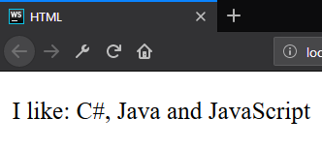
Formatting Text – Span
Span element is a generic inline container for phrasing content, which does not inherently represent anything
It can be used to group elements for styling purposes
<p>I like:
<span>C#, Java and JavaScript</span>
</p>
27

Slide 28
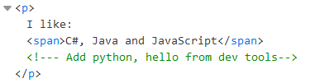
Formatting Text – Comments
Place comments in your HTML
Not visible on the page
But still visible in dev tools
<p>I like:
<span>C#, Java and JavaScript</span>
<!--- Add python, hello from dev tools -->
</p>
28

Slide 29
Attributes
id?
class?
style?
name?
Attributes for the HTML Elements

Slide 30
Attributes
An attribute is a characteristic (special words) used inside the opening tag to control the tag's behavior
An attribute is a characteristic of an element, such as font size or color
Must have space
No space allowed
No space allowed
<p id="myId"></p>
Attribute
name
Attribute
value
30

Slide 31
Attributes
Attributes are used to amplify a tag
When a web browser interprets an HTML tag, it will also look for its attributes so that it can display the web page's elements properly
Generally appear as name-value pairs, separated by '='
<div class="divElement" id="mainContainer">
In this case, the attributes will not affect the content of the div.
</div>
Full list of all HTML attributes: Link
31

Slide 32



Images, Links and Forms

Slide 33

Images
The src (source-source) attribute indicates the path to the image file
The alt (alternate-substitute) attribute defines descriptive text for users who can not see the image for some reason
33

Slide 34

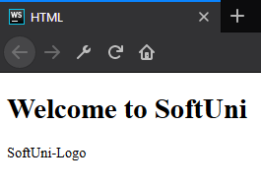
Images
<body>
<h1>Welcome to SoftUni</h1>
<img src="softuni-logo.png" alt="SoftUni-Logo"/>
</body>
<body>
<h1>Welcome to SoftUni</h1>
<img src="softuni-logo.png" alt="SoftUni-Logo"/>
</body>
Content of alt attribute
34

Slide 35
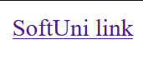
Links / References
They are the essence of the web
To add a reference, we use this simple element <a>, as it comes from anchor
It needs an attribute to hold the reference we want to make
This attribute is called href from hypertext reference
<body>
<a href="https://softuni.bg">SoftUni link</a>
</body>
35

Slide 36
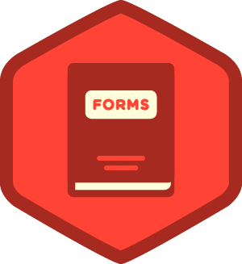
Forms
The HTML <form> element defines a form that is used to collect user input
An HTML form contains form elements
Input elements
Text fields
Checkboxes
Radio buttons
Submit buttons
36

Slide 37
Forms
<body>
<form>
<label for="fullName">Full name</label>
<input type="text" id="fullName" name="fullName"> <label for="language">Language</label>
<select id="language">
<!-- TODO: -->
<option>tags</option> </select>
<label for="knowledge">Basic Level</label>
<input type="checkbox" id="knowledge" name="language" value="yes">
<button type="submit">Submit</button>
</form>
</body>
37

Slide 38

Multimedia Content

Slide 39
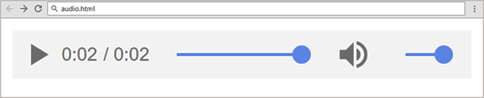
Embedding Audio
The <audio> element inserts audio player in the Web page
Audio will play automatically
<audio controls autoplay>
<source src="horse.mp3" type="audio/mpeg" />
Your browser does not support the audio tag.
</audio>
Audio file path
Audio file format
Alternative text

Slide 40
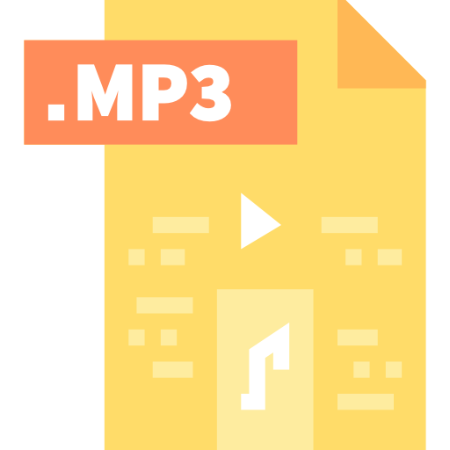


Embedding Audio
Audio formats supported:
MP3 - audio/mpeg
OGG - audio/ogg
WAV - audio/wav
Attributes:
controls
autoplay, loop, preload

Slide 41
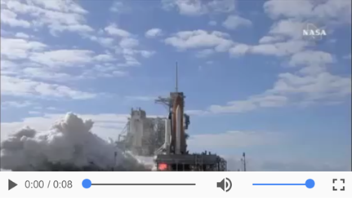
Embedding Video
The <video> element inserts video player in your site
<video controls="controls">
<source src="shuttle.mp4" type="video/mp4" />
Your browser does not support the HTML5 video.
</video>
Video file name
Audio file format
Alternative text

Slide 42

Embedding Video
Video formats supported:
MP4 - video/mp4
Ogg - video/ogg
WebM - video/webm
Attributes:
width, height
poster
controls
autoplay, loop

Slide 43

Nested Elements

Slide 44


Nested Elements
It is possible to put an element inside another element - this is called nesting
Elements need to be opened and closed properly to be truly inside or outside of each other
Some items have no content and are called empty elements
44

Slide 45
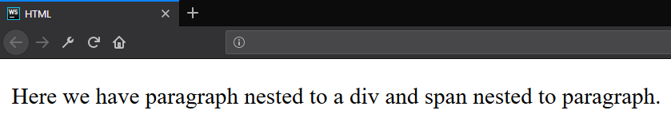
Nested Elements – Example
<div>
<p>
Here we have paragraph nested to a div and
<span>span nested to paragraph</span>.
</p>
</div>
45

Slide 46
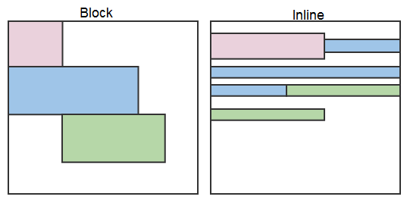
Display Properties – Block and Inline
Browsers treat every element as a kind of box
There are two types of boxes
Block
Inline

Slide 47
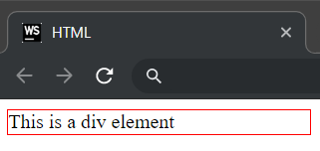
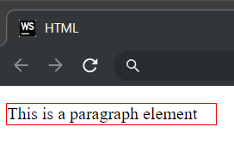
Block Elements
Always starts on a new line
Fills up the horizontal space left and right on the web page
Block elements are <div> and <p>
<div>This is a div element</div>
<p>This is a paragraph element</p>

Slide 48
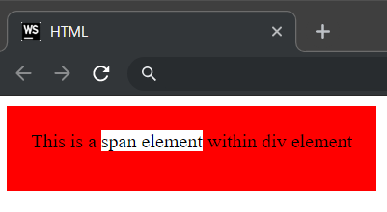
Inline Elements
Appear on the same line as the content and tags beside them
Inline elements can appear within block elements
Inline elements are <span>, <strong>, <img>
<div>This is a <span>span element</span> within a div element</div>

Slide 49

Summary
What is HTML?
Element anatomy
Document anatomy
Formatting text
Attributes
Images, Links and Forms
Multimedia context
Nested Elements
…
…
…

Slide 50
Questions?
Notes:
50

Slide 51
Trainings @ Software University (SoftUni)
Software University – High-Quality Education, Profession and Job for Software Developers
softuni.bg, softuni.org
Software University Foundation
softuni.foundation
Software University @ Facebook
facebook.com/SoftwareUniversity
Software University Forums
forum.softuni.bg
51
Notes:
51

Slide 52

License
This course (slides, examples, demos, exercises, homework, documents, videos and other assets) is copyrighted content
Unauthorized copy, reproduction or use is illegal
© SoftUni – https://softuni.org
© Software University – https://softuni.bg
Notes:
52

